Slide 1
Harold Pulcher
Senior Consultant and Microsoft MVP

Slide 2
Upcoming Virtual Training Courses
Use code Tech-Fest-2020 to take $500 off the list price for any of the courses below
PSM September 29-30
The Professional Scrum Master (PSM) certification course is a 2-day certification course that covers the principles and empirical process theory underpinning the Scrum framework, and the role of the Scrum Master in it.
PSM II October 7-8
The Professional Scrum Master II™ (PSM II) certification course is a 2-day advanced Scrum Master class designed to support Scrum Masters in their professional development. The PSM II class is intended for Scrum Masters with at least one year of experience who are looking to grow their knowledge and abilities as a Scrum Master.
PSPO October 20-21
The Professional Scrum Product Owner (PSPO) certification course is a 2-day course where participants learn how to leverage Scrum to maximize the value of products and services.
For more information or to sign-up, visit:
www.improving.com/training

Slide 3

We’re Hiring
Senior Front-End .Net Developer
– React, Node, Javascript
Senior Java Developer
Senior Full Stack Developer
Junior Full Stack Developer
– Microsoft Stack, Angular 2+
Senior .Net Developer
– .Net Core, strong SQL, backend, and testing experience
Senior .Net Developer
– .Net Full Stack with React or Angular
Send resumes to careers@improving.com
*reference your closest office (we have 14 now)

Slide 4
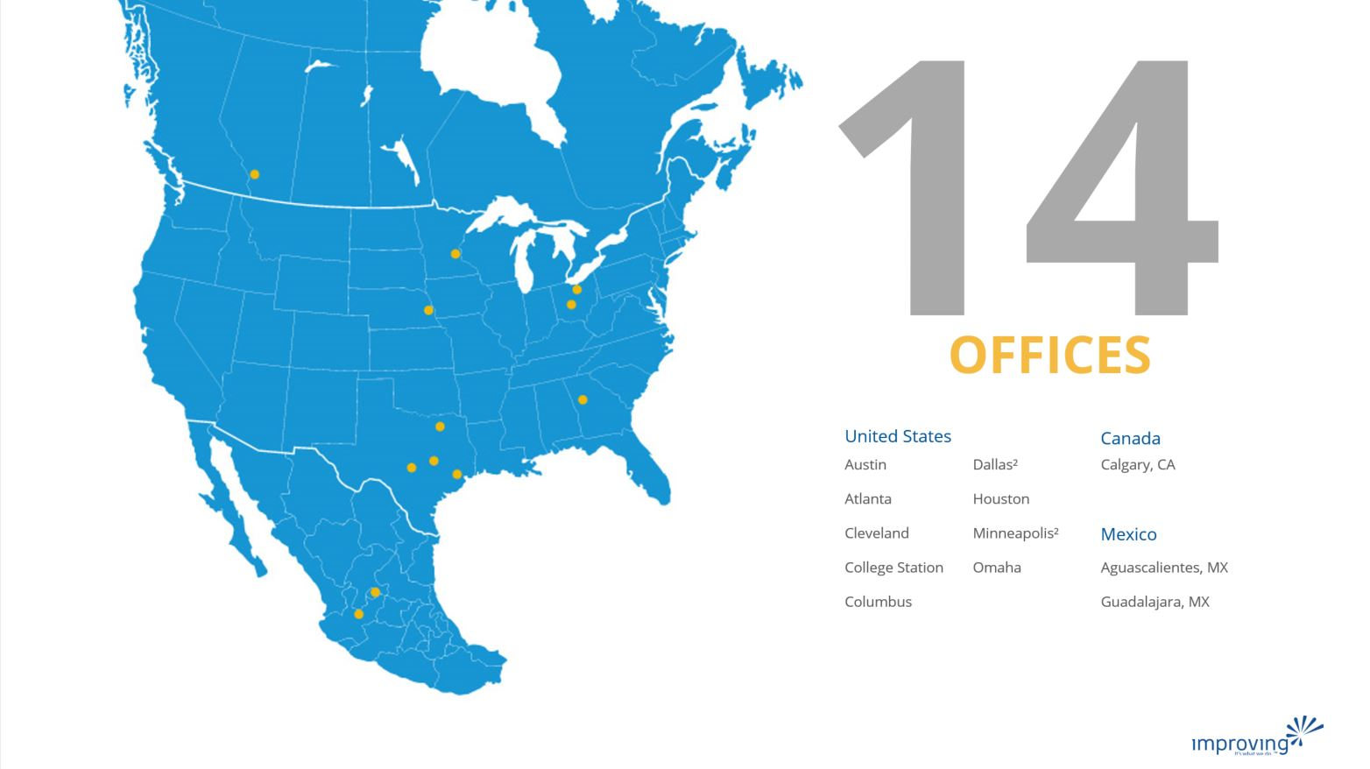
Share details about an upcoming event, conference, user group, booth raffel ect here.

Slide 5

Training class advertisement here​
For details around upcoming training courses available, please check with your local business development managers/office leadership
Fridays at 12pm CST
See past talks on our YouTube Page
https://bit.ly/2Rd0WC5

